Slide 1
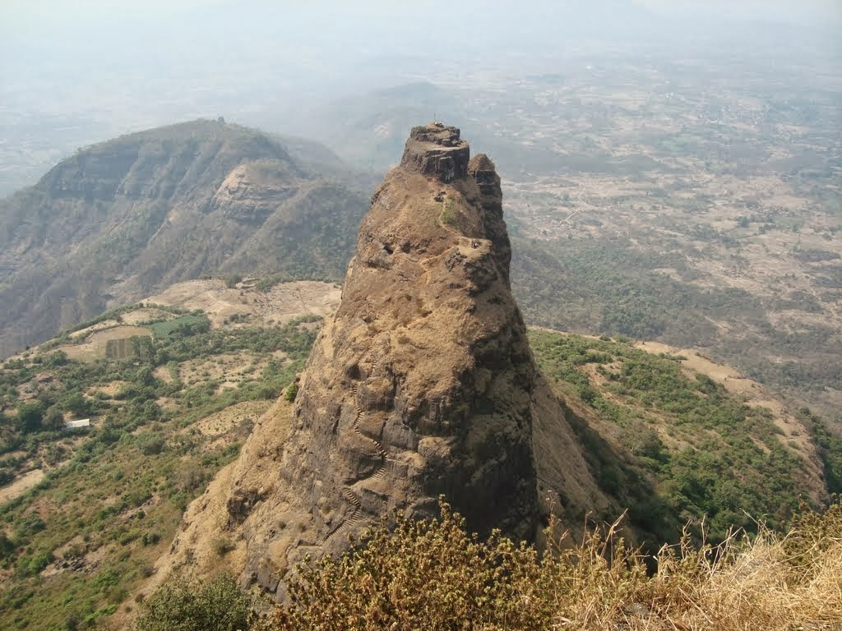
Maharashtra Trekking Club
presents
Kalavantin Durg
17th Dec 2017
CoNtact
Prathamesh:- 8698350315
Aditya:-
Viraj:-
800 /-Pune to Pune travel by private bus
www.mahatrekk.in

Slide 2
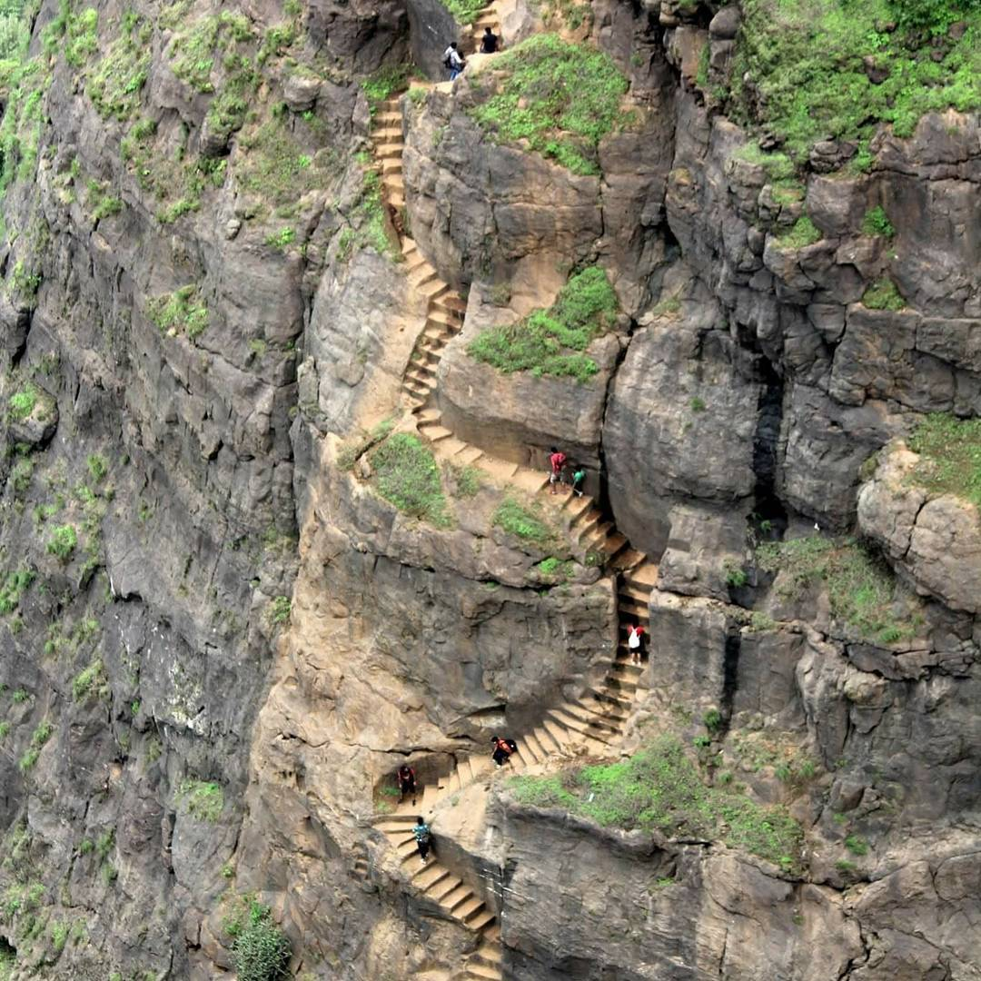
MAHARASHTRA TREKKING CLUB PRESENTS
Kalavantin Durg
17th Dec 2017
800 /- Pune to Pune travel by private bus
www.mahatrekk.in

Slide 3
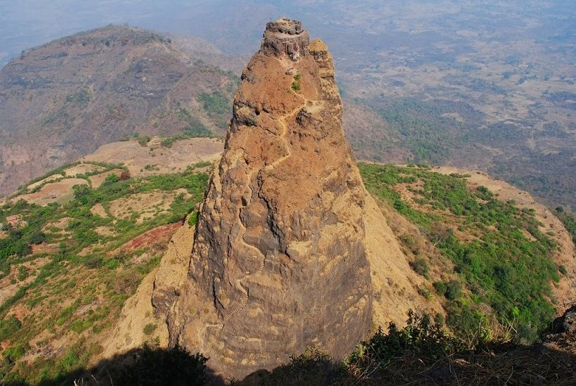
Maharashtra Trekking Club
Presents
Kalavantin Durg
17th Dec 2017
Pune
Mumbai
Viraj :-
Pranav :-
Prathamesh:- 8698350315
XYZ:-

